Slide 1



- The Best Loan Under One Roof
Bank Loan Performance Analytics
Unveiling the Hidden Insights: An In-depth Analysis of Bank Loan Analytics

Slide 2

Introduction
Welcome to the Unveiling the Hidden Insights presentation, where we will conduct an in-depth analysis of Bank Loan Analytics. Get ready to explore the complex details and gain valuable insights into the world of banking loans.
Understanding Loan Data
Dive into the loan data to comprehend the underlying patterns and trends. Analyze the factors influencing loan approval and recovery rates, and identify potential areas for improvement.

Slide 3





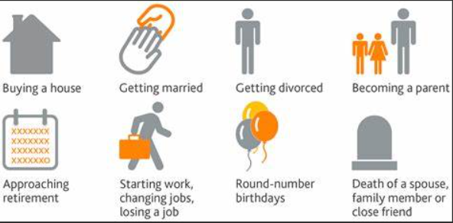





Purpose of Loans you have come cross?
Loan Purpose with Highest interest rate?
Reasons for not paying the loan

Slide 4
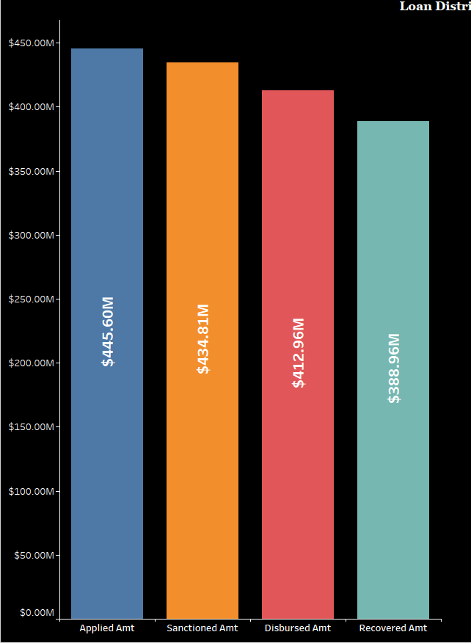
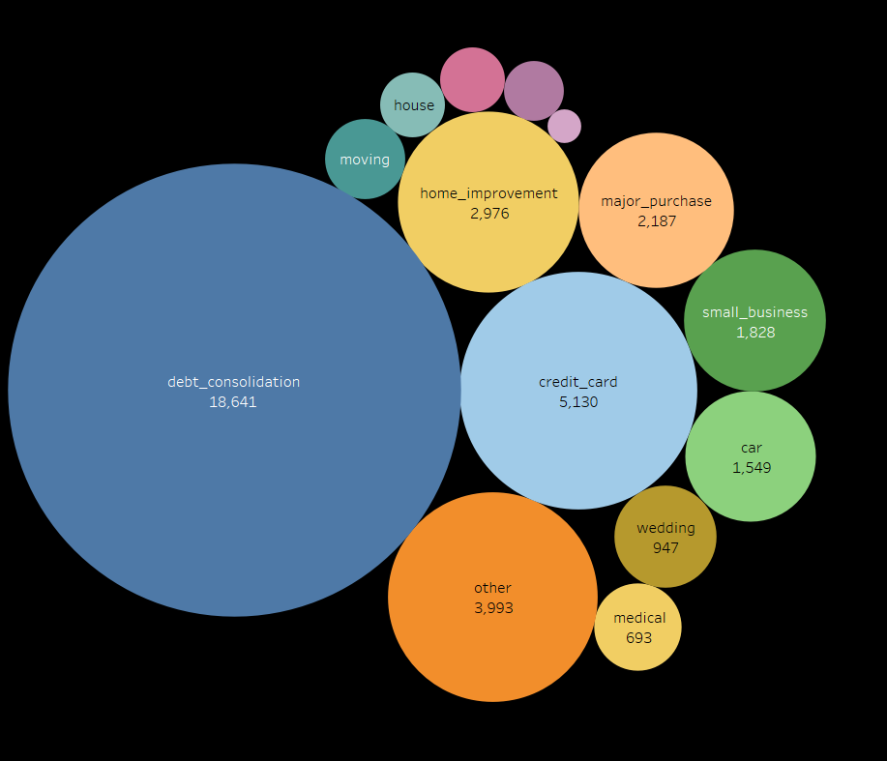
LOAN DISTRIBUTION
CUSTOMER DISTRIBUTION BY PURPOSE
The
The Total Loan Amount requested is $445.6M.
The Sanctioned Loan amount is 97.58% of the Loan Requested Amount.
Disbursed loan amount is 92.67% of the Loan Requested Amount.
Total Recovered amount is 87.27% of the Loan Requested amount.
Vacation
381
Education
325
Renewable Energy
103
The Total No of Customers are 39,717.
The maximum no of customers are for the purpose Debt Consolidation.
The Least no of customers are for the purpose Renewable energy.

Slide 5
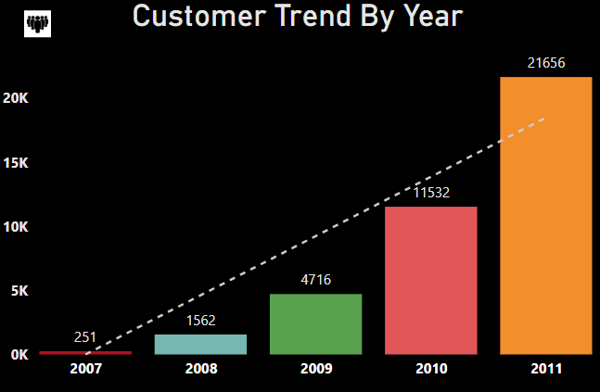


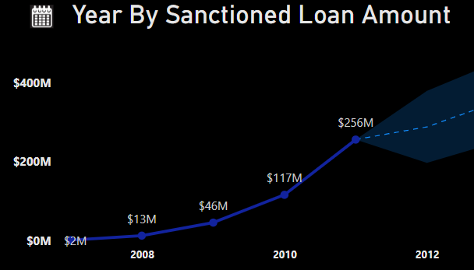
The Maximum number of
customers are for the year
2011 which is 21656.
The minimum number of customers are for the year 2007 which is 251.
The trend line is showing a tremendous increase in the
no of customers year on
year.
CUSTOMER TREND BY YEAR
SANCTIONED AMOUNT BY YEAR
The minimum amount sanctioned is for the year 2007 which is $2M.
The maximum amount sanctioned is for the year 2011 which is $256M
The estimated sanctioned amount for the next two years has been forecasted in the graph
$352M
$288M

Slide 6
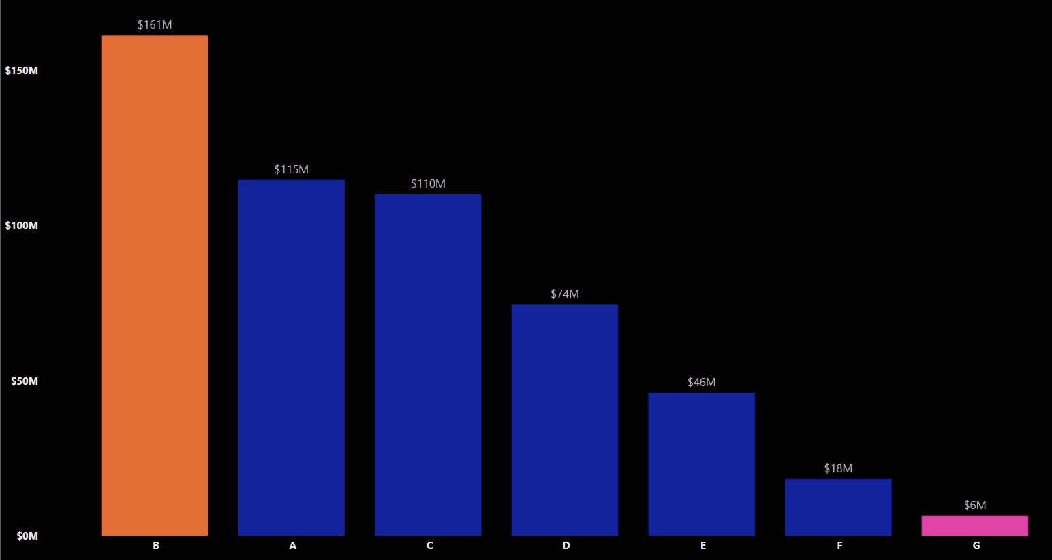
REVOLVING BALANCE BY GRADE AND SUB-GRADE
Revolving balance is the amount of credit that is unpaid at the end of the billing cycle
The maximum revolving balance is for Grade B
The minimum revolving balance is for the Grade G

Slide 7
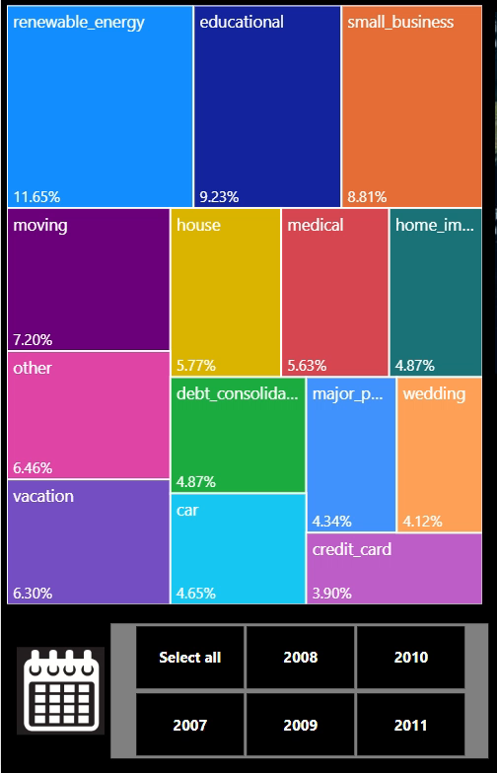
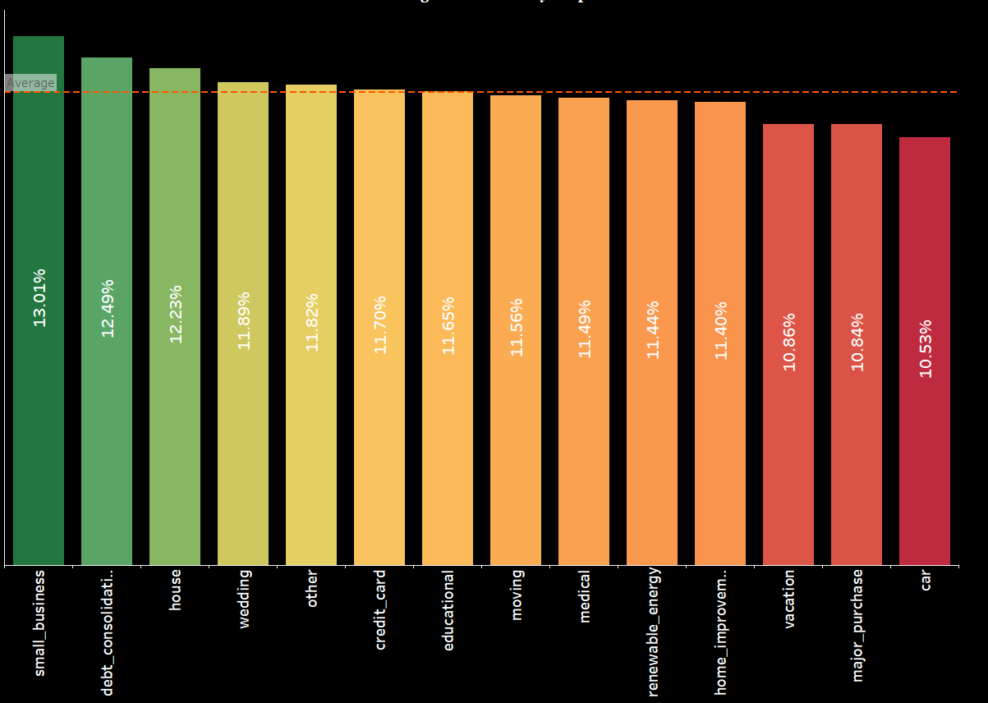
PURPOSE BY LATE FEE %
The purpose credit card has the least no of customers paying the Late fee which is 3.90%
The purpose Renewable energy has the maximum no of customers paying the late fee which is 11.65%
AVG. INTEREST RATE % BY PURPOSE
11.72%.
The average interest rate is 11.72%.
The interest rate for purposes like small business, debt consolidation, house, wedding, others have more than average interest rate

Slide 8
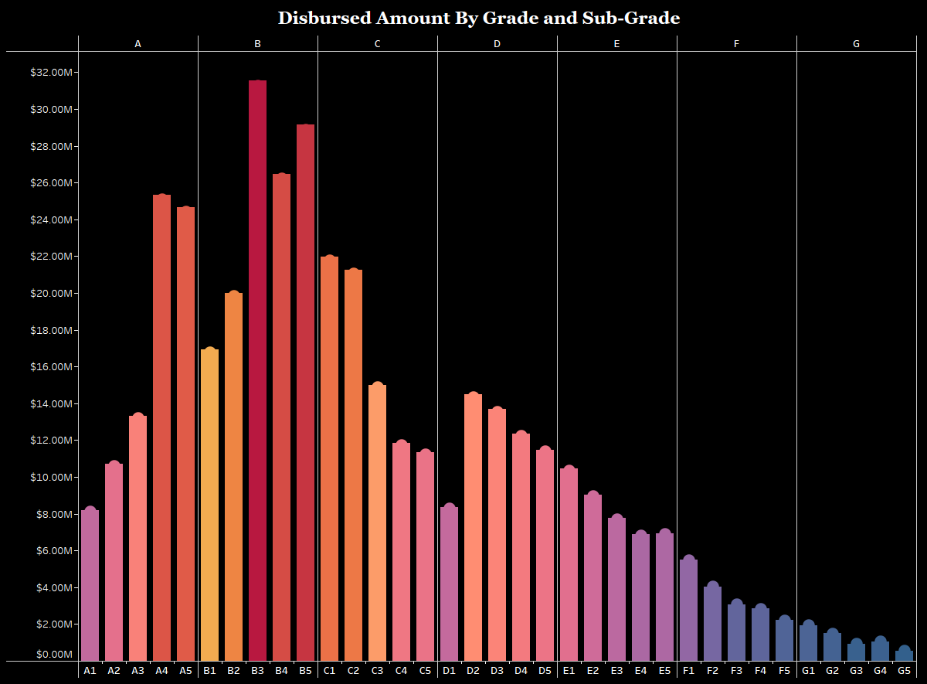
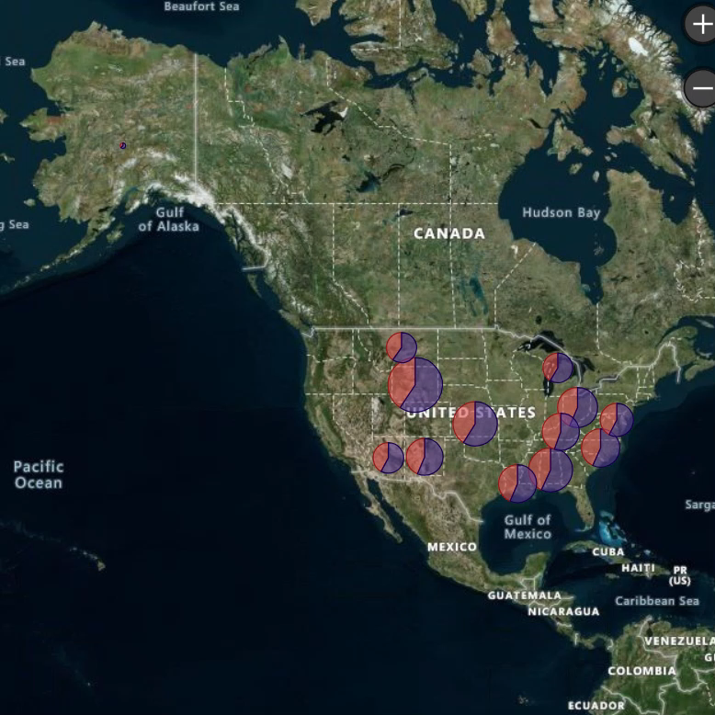
DISBURSED AMOUNT BY GRADE AND SUB-GRADE
TOP 15 STATES BY PROFIT% & VERIFICATION STATUS
Grade B and sub-Grade B3 has the highest Disbursed amount.
Grade G and Sub-Grade G5 has the least disbursed amount
NOT - VERIFIED
VERIFIED
The highest profit % is for WY. For Verified-26.38% & Not-Verified – 18.07%.
The least profit % is for AZ. For Verified-23.20% & Not-Verified – 16.86%.

Slide 9
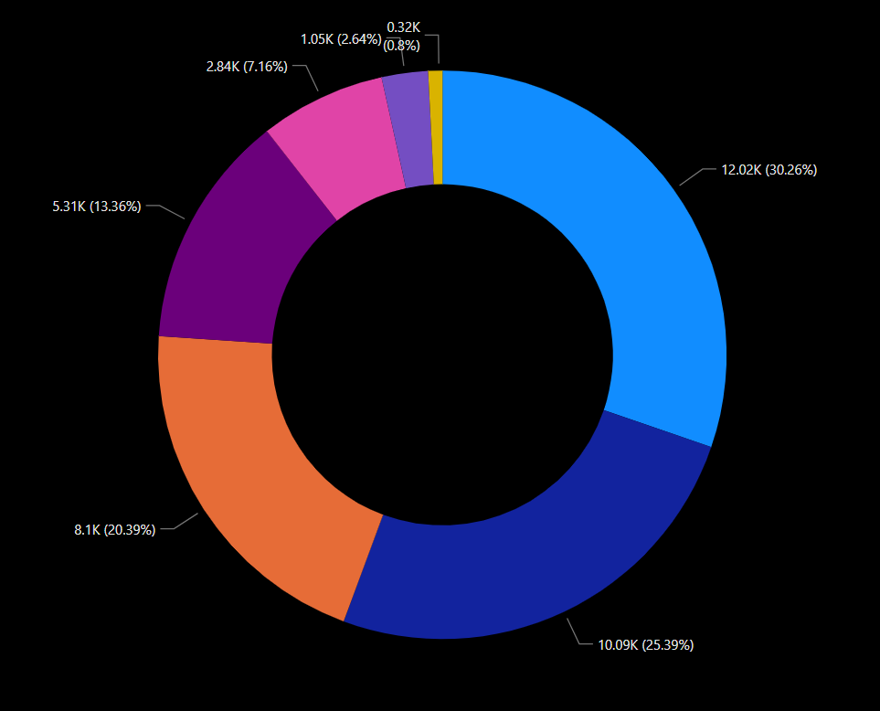
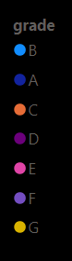
CUSTOMERS BY GRADE
Total Customers
39,717

Slide 10
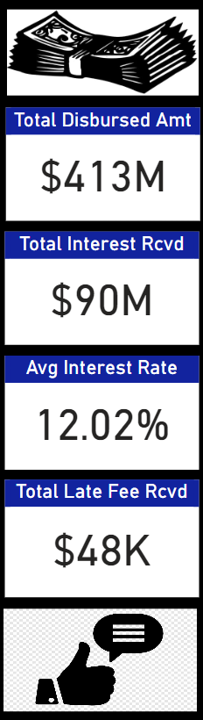
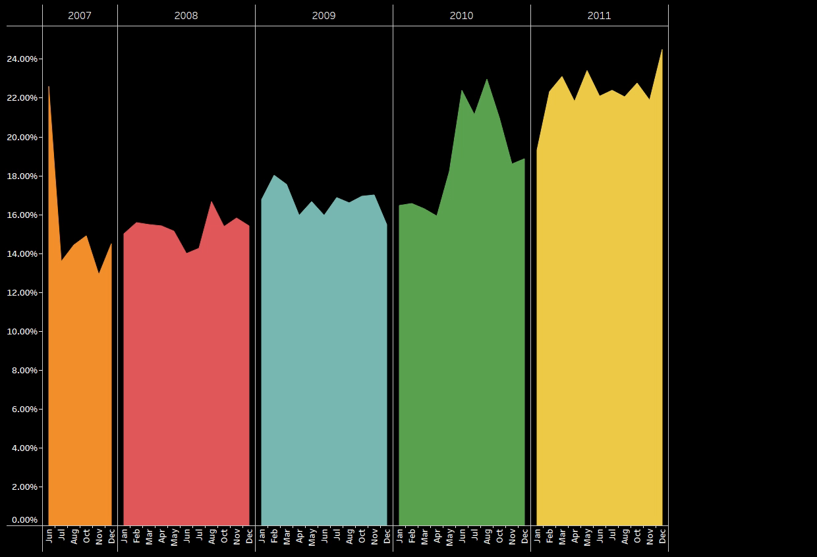
PROFIT % BY MONTH & YEAR

Slide 11
Analyzing Bank Loan Performance
S
W
O
T
STRENGHT
WEAKNESS
OPPORTUNITIES
THREATS
Diverse Loan Portfolio
Established Customer Base
Risk Management Expertise
Operational Inefficiencies
Non-Performing Loan
Personalized Loan Offerings
Loan Tenure
Green Financing
Economic Downturn
Interest Rate Volatility
Competition from Non-Banking Entities

Slide 12

Conclusion and Key Takeaways
Loans taken for renewable energy seem to have a higher late fee associated with them, with approximately 11.65% of customers not paying their EMIs on time.
1
2
The bank consistently experiences lower profits in the month of April compared to other months each year
Interestingly, unsecured loans such as Debt Consolidation (18641, 12.49%) and credit cards (5130, 11.70%) have a significant number of customers, despite the fact that they come with relatively high interest rates
3
4
It appears that customers who have Rent and Mortgage as their ownership status are more inclined to take out loans
5
Embracing digital channels for loan origination, servicing, and customer interactions

Slide 13

QUESTION & ANSWERS

Slide 14

Keep Banking with us!!!

